Slide 1


Bhumiputra
Crop Disease Detection Using Image Processing

Slide 2
Outline
Introduction
1
2
Flow Diagram
Innovation
4
Conclusion
3

Slide 3
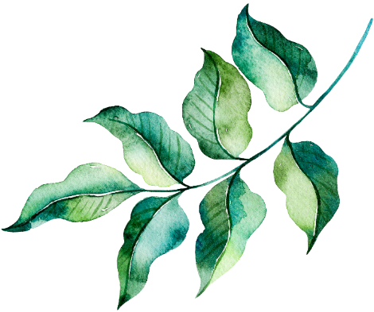
INTRODUCTION
Detection of Diseases in Leaves is important milestone in conserving not just biodiversity but also
saving crops from disease spread.
The algorithm has aided the process of leaf detection by the
monitoring of some basic features of leaves and then comparing the
values obtained with the available data set.

Slide 4
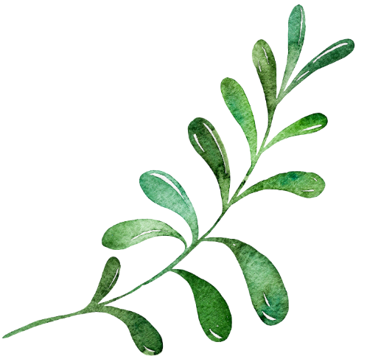
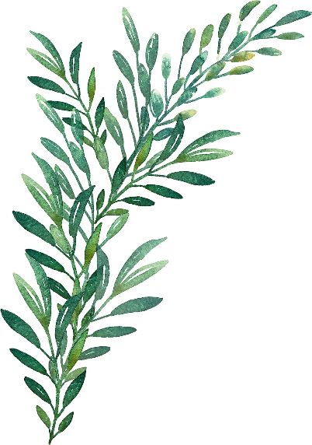
This Hack tackles a major concern seen among farmers in rural areas.
Presenting a pratotype system for
detection and classification of crop diseases based on images of infected crop plants.
This project will help farmers to use best of everything in best ratio and aspects like proper use of
Pesticides, Fertilizers,

Slide 5
Flow Diagram Of Leaf Detection
Capure Digital Leaf Image
Process Image
Extract Features
Display And Compare Result
Disease Detection In Leaf

Slide 6
SWOT ANALYSIS
Strength:-
Our idea will totally support the concept of DIGITAL INDIA.
Farmers will get the direct benefit from this as their awareness and knowledge regarding productive farming will increase.
Overall yield of the farmers will increase at a tremendous rate.
Using Data Analytics the decisions will be more precise.
Weakness:-
Availability of Internet connection in remote areas.
The main dependency is the data.

Slide 7
Opportunity:
Employment in implemented areas to operate the device/software.
Opportunity of connecting and collecting the
farm’s data for further research and development.
Threats:-
1.Data Hacking.
2.Viruses can be encountered on propagation
of data on internet.

Slide 8
INNOVATION
2.
Smart approach towards identification of disease and making it faster to give required solution instantly.
1.
Indian farmers will get the proper knowledge of smart and productive farming.
3.
Data Analysis and Machine Learning concepts will definitely led us to a better and precise prediction.
4.
The increment in crop production will led to improved conditions of an Indian farmer.

Slide 9
CONCLUSION
Various techniques to bifurcate the disease part of the plant.
Classification techniques to extract the features of infected leaf and the classification of plant diseases.
The use of ANN methods for classification of disease in plants such as self organizing feature map, back propagation algorithm, SVMs etc. can be efficiently used.

Slide 10
THANKS FOR LISTENING
By:- Sahil Niranjan
Abhishek Saini
Avni Goel
Yash Sharma

